Slide 1
Lecture 7. Hypothesis Testing
Математичні моделі у продуктовому маркетингу

Slide 2
Lecture 3 Goals: Hypothesis Testing
Know random variables and sampling Models
Understand the Law of Large Numbers
Differentiate parameters and estimates
Be able to interpret confidence intervals and p-values
Know the principles of hypothesis testing
Know how to choose and interpret statistical test
Be able to perform tests in Excel and R

Slide 3

Statistical Inference
! Remember, every time we sample from a population, the values in the sample are likely to shift because of the random process of sampling.
! But, according to the Central Limit Theorem, if the sample size is large enough, the MEANS of repeated samples will be normally distributed with a mean of $μ$ and a standard deviation of $σ/√n$ (Standard Error, SE).
Analysis of Sample Statistics and Distribution
Apply Sampling Theory (Central Limit Theorem )
Make Statements about the Population of Interest
Statistical Significance (noise smaller than signal)
Point Estimates
Interval Estimates

Slide 4

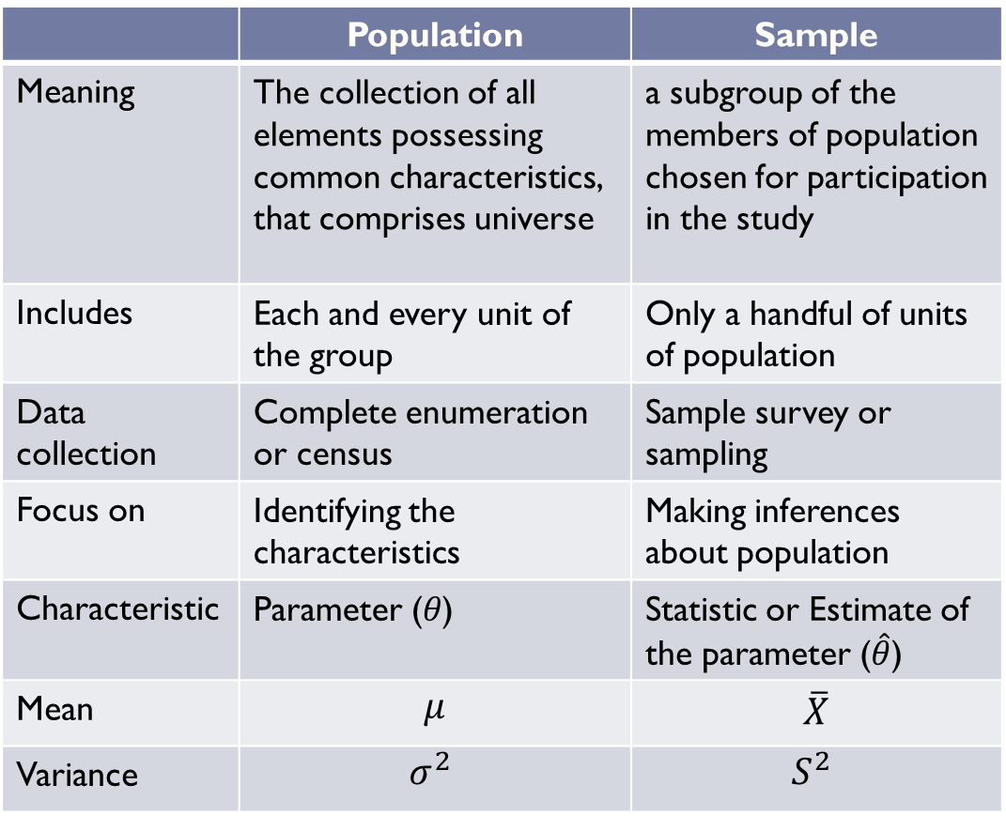
Inferential Statistics
 | Population | Sample
Meaning | The collection of all elements possessing common characteristics, that comprises universe | a subgroup of the members of population chosen for participation in the study
Includes | Each and every unit of the group | Only a handful of units of population
Data collection | Complete enumeration or census | Sample survey or sampling
Focus on | Identifying the characteristics | Making inferences about population
Characteristic | Parameter (𝜃) | Statistic or Estimate of the parameter ($\hat{θ}$)
Mean | $$μ$$ | $$\overline{X}$$
Variance | $$σ^{2}$$ | $$S^{2}$$

Slide 5
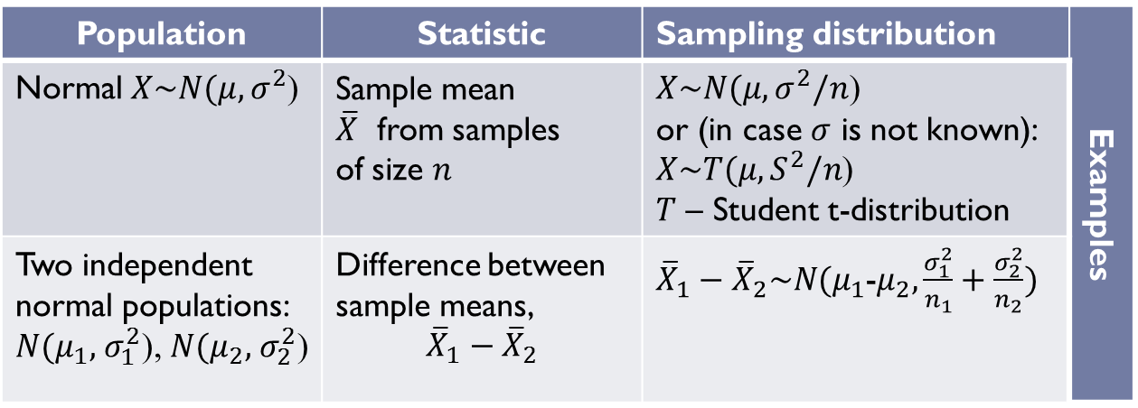

Sampling distribution
The sampling distribution of a statistic is the distribution of that statistic, considered as a random variable, when derived from a random sample of size $n$.
Sampling distribution depends on:
the formula for estimating parameter $θ(x_{1},x_{2},…,x_{n})$;
probability distribution function, pdf, $x_{i},f\left(x_{i}\right)$ and sample size $n.$
Population | Statistic | Sampling distribution | Examples
Normal $X\sim N(μ,σ^{2}$) | Sample mean $\overline{X}$ from samples of size $n$ | $X\sim N(μ,σ^{2}/n$) or (in case $σ$ is not known): $X\sim T(μ,S^{2}/n$) $T$ – Student t-distribution
Two independent normal populations: $N(μ_{1},$ $σ_{1}^{2}$), $N(μ_{2},$ $σ_{2}^{2}$) | Difference between sample means, $${\overline{X}}_{1}−{\overline{X}}_{2}$$ | ${\overline{X}}_{1}−{\overline{X}}_{2}\sim N(μ_{1}$-$μ_{2}, \frac{σ_{1}^{2}}{n_{1}}+\frac{σ_{2}^{2}}{n_{2}})$

Slide 6
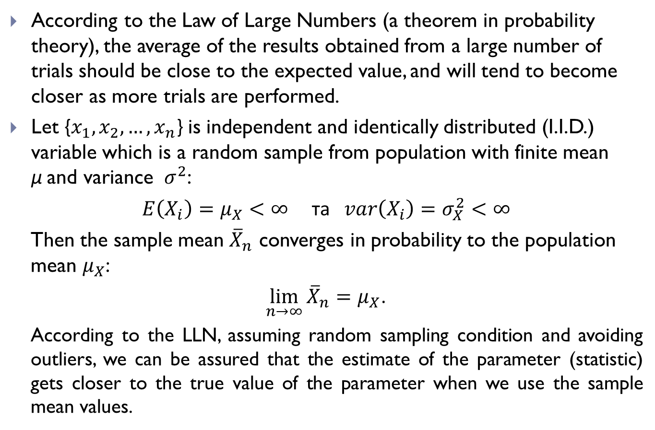
Law of Large Numbers (LLN)
According to the Law of Large Numbers (a theorem in probability theory), the average of the results obtained from a large number of trials should be close to the expected value, and will tend to become closer as more trials are performed.
Let {$x_{1},x_{2},…,x_{n}$} is independent and identically distributed (I.I.D.) variable which is a random sample from population with finite mean μ and variance ${ σ}^{2}$:
$E\left(X_{i}\right)=μ_{X}<∞$ та $var\left(X_{i}\right)=σ_{X}^{2}<∞$
Then the sample mean ${\overline{X}}_{n}$ converges in probability to the population mean $μ_{X}$:
$\lim_{n→∞}{{\overline{X}}_{n}}=μ_{X}$.
According to the LLN, assuming random sampling condition and avoiding outliers, we can be assured that the estimate of the parameter (statistic) gets closer to the true value of the parameter when we use the sample mean values.

Slide 7
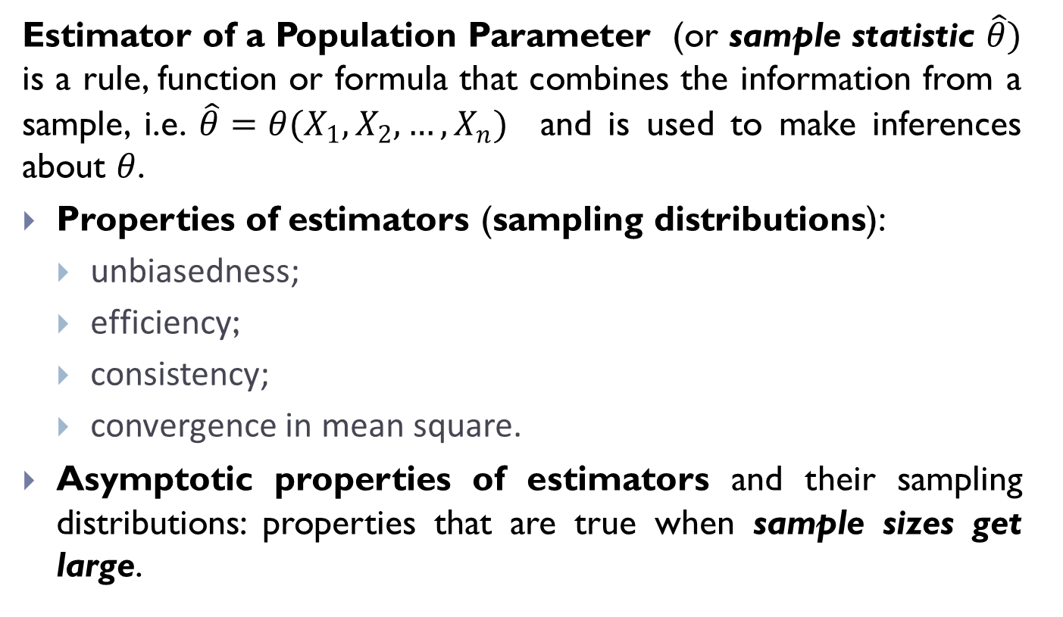
Estimator of the Parameter
Estimator of a Population Parameter (or sample statistic $\hat{θ})$ is a rule, function or formula that combines the information from a sample, i.e. $\hat{θ}=θ(X_{1},X_{2},…,X_{n})$ and is used to make inferences about $θ$.
Properties of estimators (sampling distributions):
unbiasedness;
efficiency;
consistency;
convergence in mean square.
Asymptotic properties of estimators and their sampling distributions: properties that are true when sample sizes get large.

Slide 8
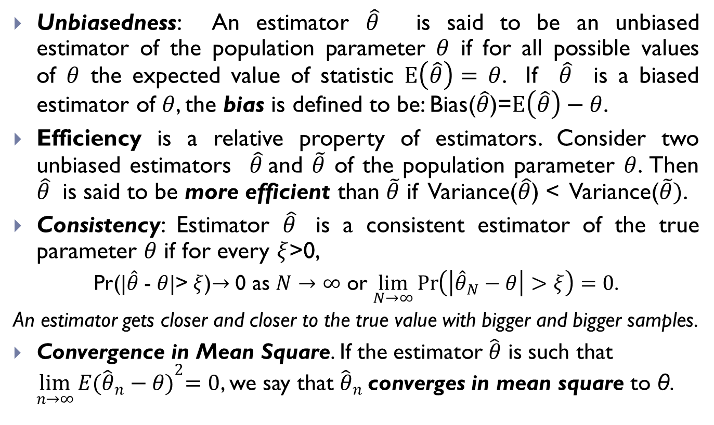
Properties of Estimators
Unbiasedness: An estimator $\hat{θ}$ is said to be an unbiased estimator of the population parameter $θ$ if for all possible values of $θ$ the expected value of statistic $E\left(\hat{θ}\right)=$ $θ$. If $\hat{θ}$ is a biased estimator of $θ$, the bias is defined to be: Bias($\hat{θ}$)=$E\left(\hat{θ}\right)−θ$.
Efficiency is a relative property of estimators. Consider two unbiased estimators $\hat{θ}$and $\tilde{θ}$ of the population parameter $θ$. Then $\hat{θ}$ is said to be more efficient than $\tilde{θ}$ if Variance($\hat{θ}$) < Variance($\tilde{θ})$.
Consistency: Estimator $\hat{θ}$ is a consistent estimator of the true parameter $θ$ if for every $ξ$>0,
Pr(|$\hat{θ}$- $θ$|>$ξ$)$→$ 0 as $N→∞$ or $\lim_{N→∞}{\operatorname{Pr}\left(\left|{\hat{θ}}_{N}−θ\right|>ξ\right)=0}$.
An estimator gets closer and closer to the true value with bigger and bigger samples.
Convergence in Mean Square. If the estimator $\hat{θ}$ is such that $\lim_{n→∞}{E{({\hat{θ}}_{n}−θ)}^{2}=0}$, we say that ${\hat{θ}}_{n}$converges in mean square to θ.

Slide 9
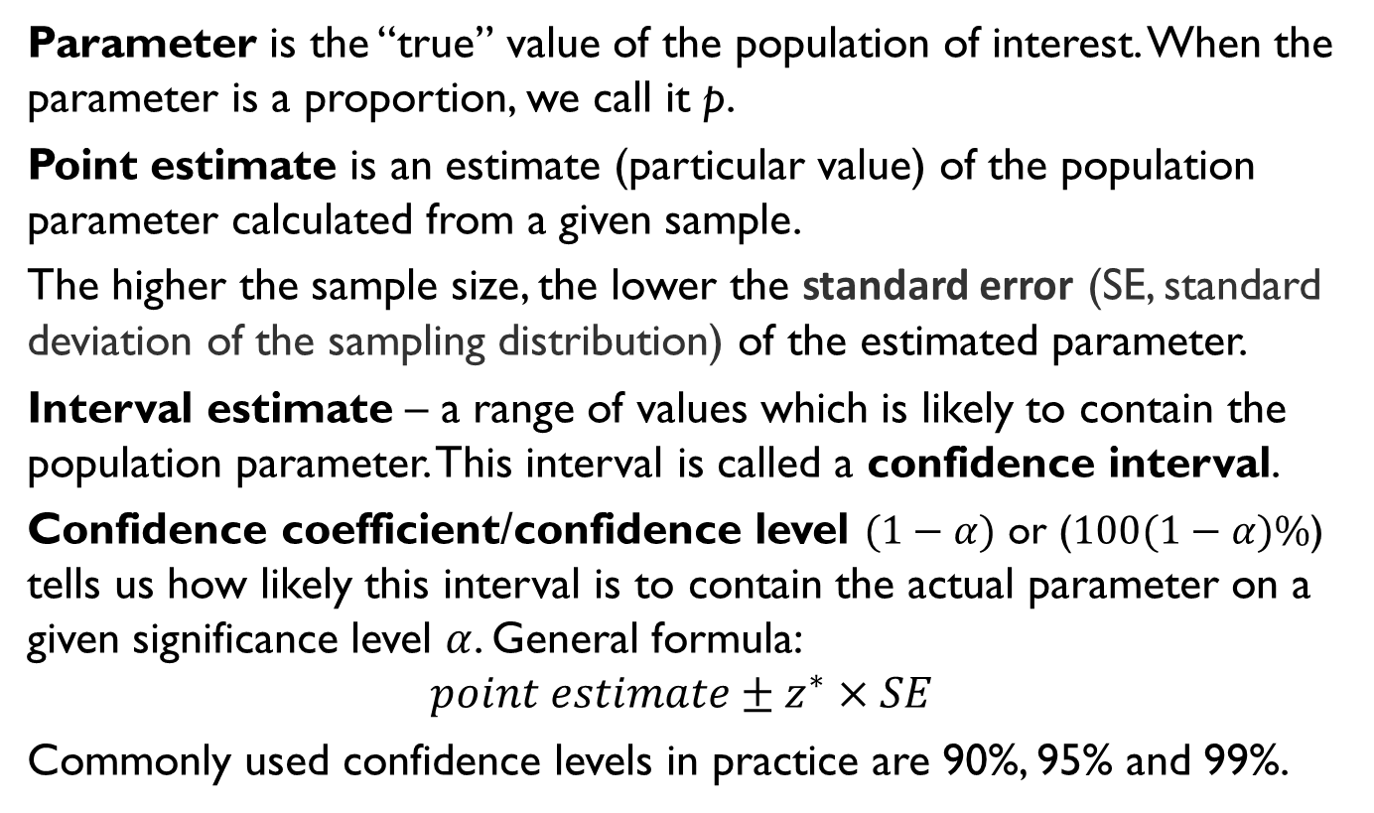
Estimates of the Parameters
Parameter is the “true” value of the population of interest. When the parameter is a proportion, we call it p.
Point estimate is an estimate (particular value) of the population parameter calculated from a given sample.
The higher the sample size, the lower the standard error (SE, standard deviation of the sampling distribution) of the estimated parameter.
Interval estimate – a range of values which is likely to contain the population parameter. This interval is called a confidence interval.
Confidence coefficient/confidence level $(1−α)$ or ($100(1−α)\%$) tells us how likely this interval is to contain the actual parameter on a given significance level $α$. General formula:
$$point estimate±z^{∗}×SE$$
Commonly used confidence levels in practice are 90%, 95% and 99%.

Slide 10
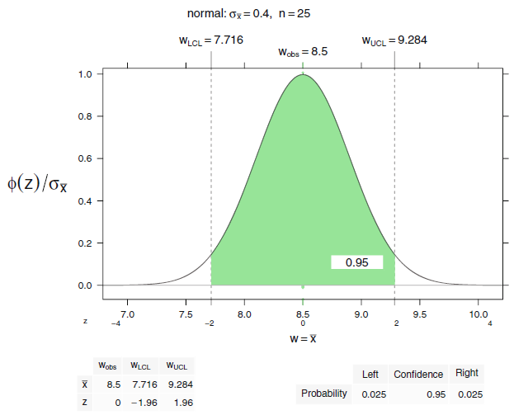
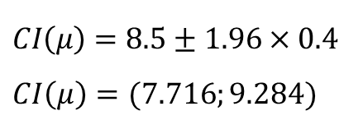

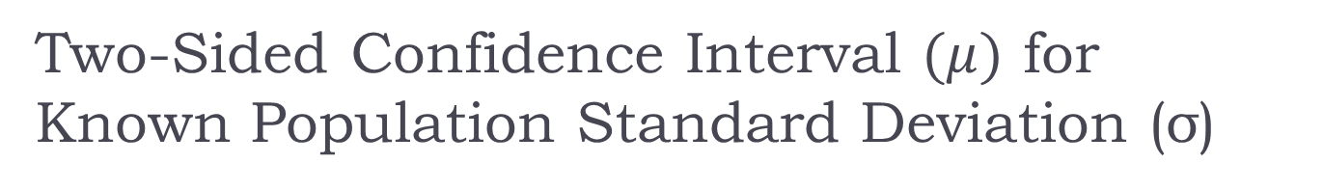
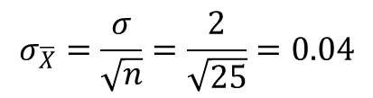

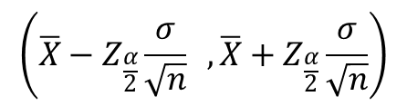
Two-Sided Confidence Interval $(μ)$ for Known Population Standard Deviation (σ)
$$\left(\overline{X}−Z_{\frac{α}{2}}\frac{σ}{\sqrt{n}} , \overline{X}+Z_{\frac{α}{2}}\frac{σ}{\sqrt{n}}\right)$$
$Z_{\frac{α}{2}}$ -
Critical value of the standardized normal statistics
$$Z_{\frac{0.95}{2}}=1.96$$
Standard Error:
$$σ_{\overline{X}}=\frac{σ}{\sqrt{n}}=\frac{2}{\sqrt{25}}=0.04$$
$$CI\left(μ\right)=8.5±1.96×0.4$$
$$CI\left(μ\right)=(7.716;9.284)$$

Slide 11
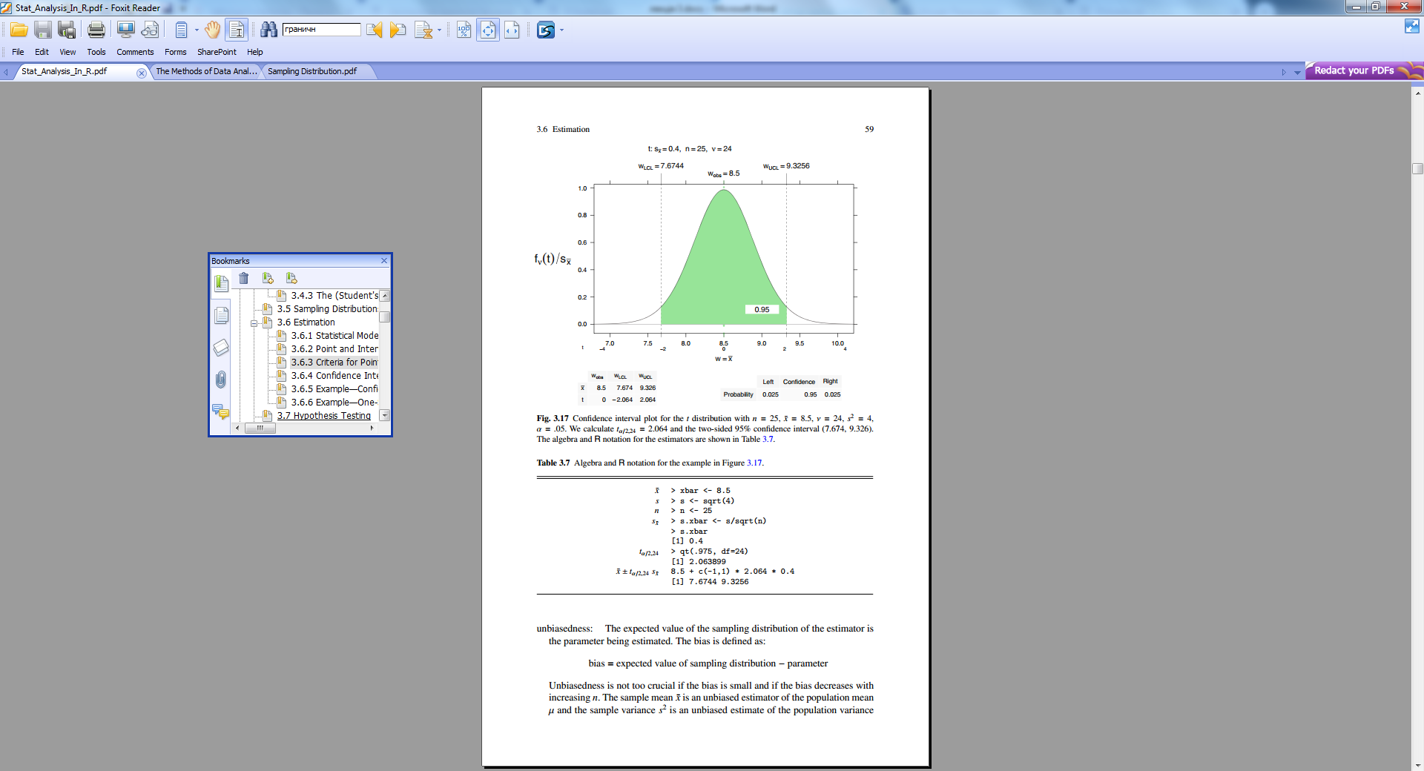
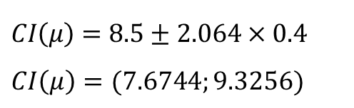
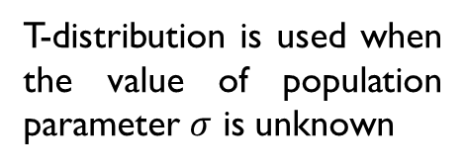
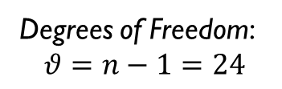

Two-Sided Confidence Interval for t-distribution
$$\overline{X}±t_{α/2,θ}S_{\overline{X}} =\left(\overline{X}−t_{α/2,θ}S_{\overline{X}} , \overline{X}+t_{α/2,θ}S_{\overline{X}} \right)$$
t-statistics (critical value):
$$t_{0.05/2, 2.24}=2.064$$
Degrees of Freedom:
$$θ=n−1=24$$
T-distribution is used when the value of population parameter $σ$ is unknown
$$CI\left(μ\right)=8.5±2.064×0.4$$
$$CI\left(μ\right)=(7.6744;9.3256)$$

Slide 12
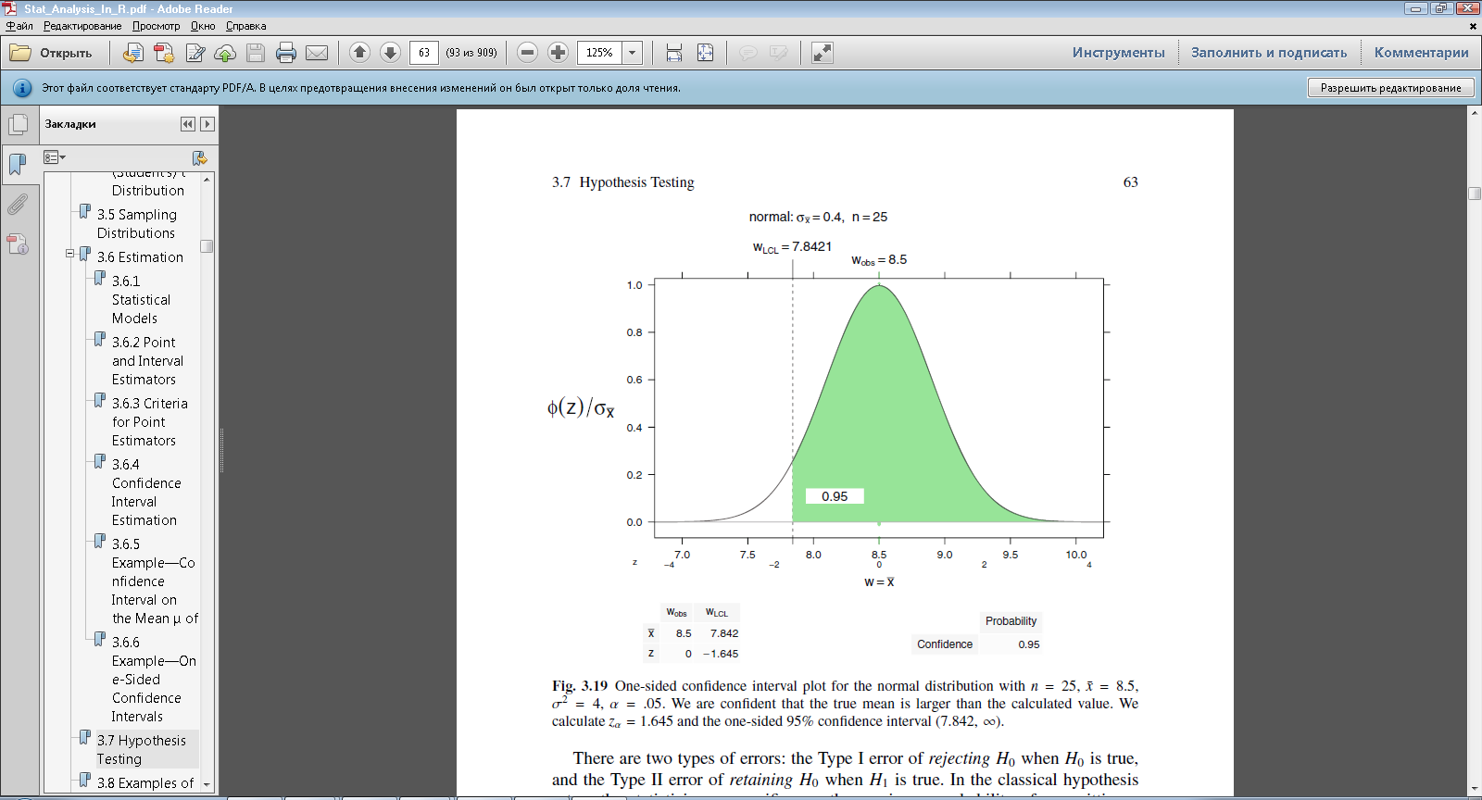

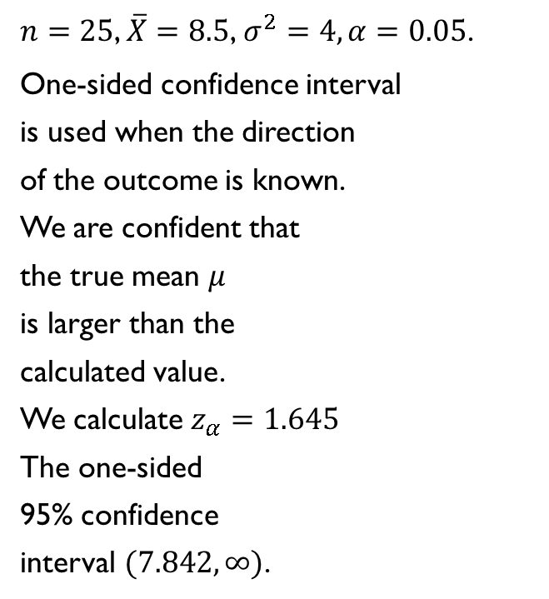
One-sided confidence interval $(μ)$ for the normal distribution
$n=25$, $\overline{X}=8.5$,$σ^{2}=4, α=0.05$.
One-sided confidence interval
is used when the direction
of the outcome is known.
We are confident that
the true mean $μ$
is larger than the
calculated value.
We calculate $z_{α}=1.645$
The one-sided
95% confidence
interval $(7.842, ∞)$.

Slide 13
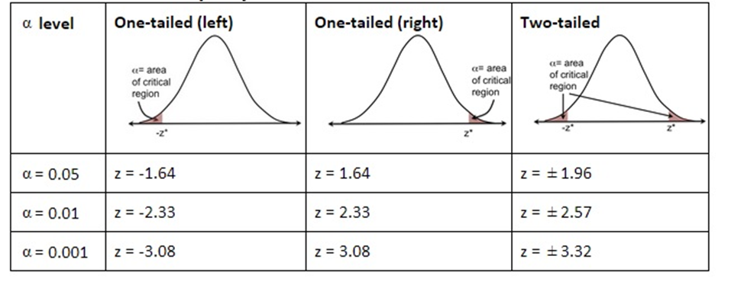
Hypothesis Testing: choosing significance level and statistics for normal distribution

Slide 14
Hypothesis Testing Process
Null Hypothesis (“status quo”) vs. Alternative Hypothesis
Idea
Define the statement that you are seeking to support through data analysis (‘alternative hypothesis’ H_{A})
Define the opposite statement (‘null hypothesis’ H₀)
Anchor your analysis by assuming that H₀ is the truth.
Observe sample data
Determine how unlikely it is to observe what you just observed if H₀ were true, thereby indirectly giving empirical support to H_{A}

Slide 15
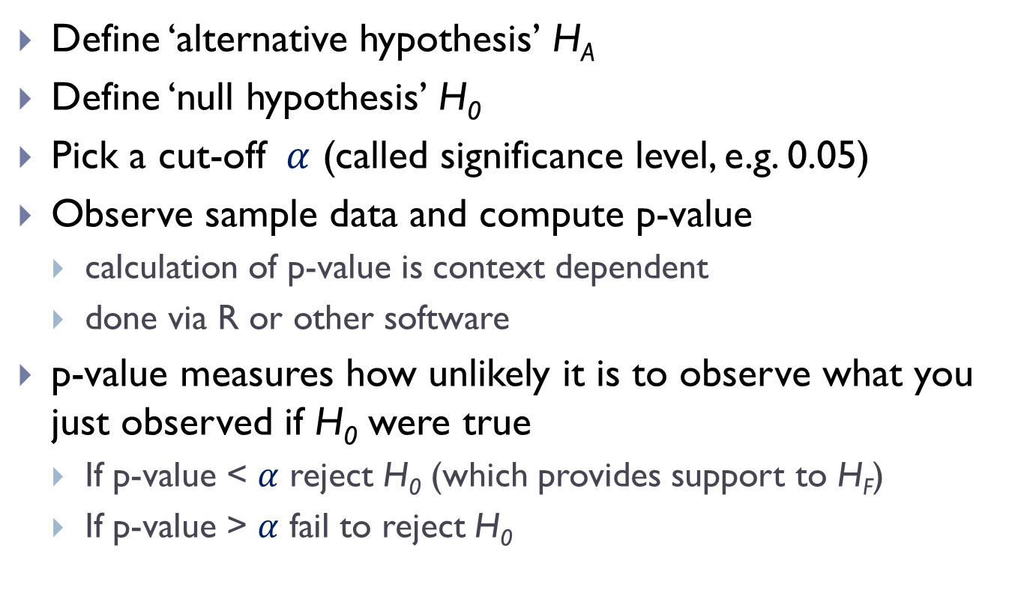
Hypothesis Testing Execution
Define ‘alternative hypothesis’ H_{A}
Define ‘null hypothesis’ H₀
Pick a cut-off $α$ (called significance level, e.g. 0.05)
Observe sample data and compute p-value
calculation of p-value is context dependent
done via R or other software
p-value measures how unlikely it is to observe what you just observed if H₀ were true
If p-value < $α$ reject H₀ (which provides support to H_{F})
If p-value > $α$ fail to reject H₀

Slide 16
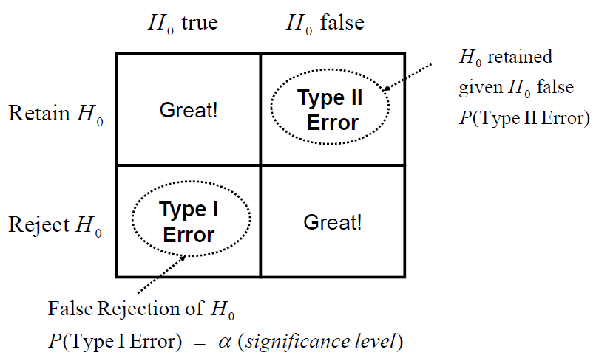
Hypothesis Testing: Four scenarios

Slide 17
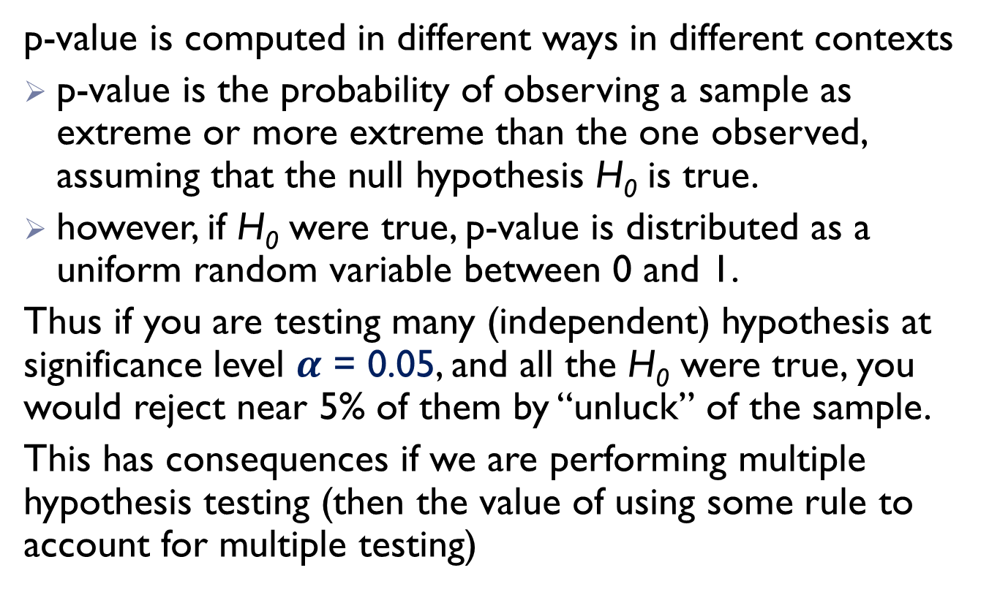
Hypothesis Testing: Caution!
p-value is computed in different ways in different contexts
p-value is the probability of observing a sample as extreme or more extreme than the one observed, assuming that the null hypothesis H₀ is true.
however, if H₀ were true, p-value is distributed as a uniform random variable between 0 and 1.
Thus if you are testing many (independent) hypothesis at significance level $α$ = 0.05, and all the H₀ were true, you would reject near 5% of them by “unluck” of the sample.
This has consequences if we are performing multiple hypothesis testing (then the value of using some rule to account for multiple testing)

Slide 18
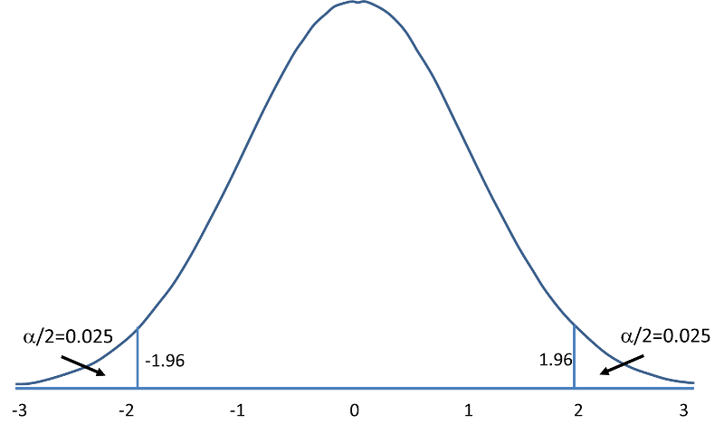
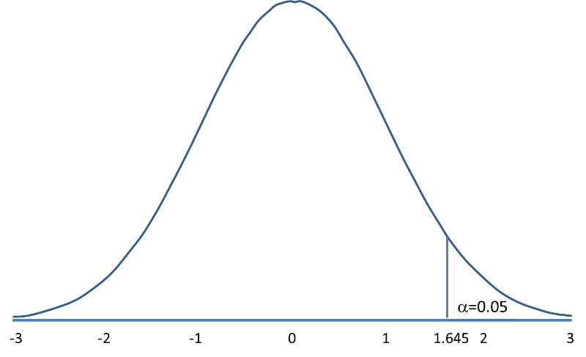


Hypothesis Testing:
Critical region
Critical region
Critical region
Two-Tail Test
One-Tail Test
$$H_{0}:μ=μ_{0 }{ H}_{A}:μ≠μ_{0}$$
$$H_{0}:μ=μ_{0 }{ H}_{A}:μ>μ_{0}$$
The critical region is the region of values that corresponds to the rejection of the null hypothesis at some chosen probability level. The shaded area under the distribution curve is equal to the level of significance.

Slide 19
Types of Statistical Tests
Type of Test | Use
Parametric Tests
Correlational | Look for an association between variables
Pearson correlation | Tests for the strength of the association between two continuous variables
Spearman correlation | Tests for the strength of the association between two ordinal variables (does not rely on the assumption of normally distributed data)
Chi-square | Tests for the strength of the association between two categorical variables

Slide 20
Types of Statistical Tests
Type of Test | Use
Parametric Tests
Comparison of Means: look for the difference between the means of variables
Z-test | Tests for the difference between two normally distributed variables
Paired T-test | Tests for the difference between two related variables
Independent T-test | Tests for the difference between two independent variables
ANOVA | Tests for the difference between two independent variables

Slide 21
Types of Statistical Tests
Type of Test | Use
Regression: assess if change in one variable predicts change in another variable
Simple regression | Tests how change in the predictor variable predicts the level of change in the outcome variable
Multiple regression | Tests how change in the combination of two or more predictor variables predict the level of change in the outcome variable

Slide 22
Types of Statistical Tests
Type of Test | Use
Non-parametric: used when the data does not meet assumptions required for parametric tests
Wilcoxon rank-sum test | Tests for the difference between two independent variables – takes into account magnitude and direction of difference
Wilcoxon sign-rank test | Tests for the difference between two related variables – takes into account the magnitude and direction of difference
Sign test | Tests if two related variables are different – ignores the magnitude of change, only takes into account direction

Slide 23
Choosing a Statistical Test
Comparing within one group
What are you comparing?
Comparing b/n two groups
How many data collection time points do you have?
1
Retrospective Pre/Post test
2
3
4
Pre-test, Post-test
Pre-test, Test 1, Test2, Post-test
> 30
What is the sample size?
< 30
Nominal
Binary
Ordinal
Categorical
What is the type of data?
Interval
Continuous
What is the distribution of data?
Normal
Non-Normal

Slide 24
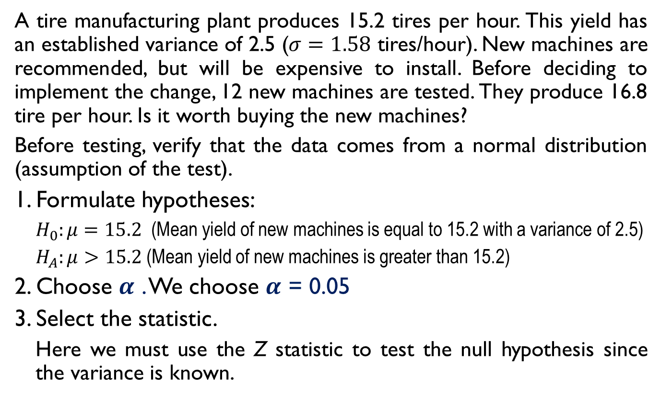
Hypothesis Testing: Example 1
A tire manufacturing plant produces 15.2 tires per hour. This yield has an established variance of 2.5 ($σ=1.58$ tires/hour). New machines are recommended, but will be expensive to install. Before deciding to implement the change, 12 new machines are tested. They produce 16.8 tire per hour. Is it worth buying the new machines?
Before testing, verify that the data comes from a normal distribution (assumption of the test).
1. Formulate hypotheses:
$H_{0}:μ=15.2$ (Mean yield of new machines is equal to 15.2 with a variance of 2.5)
$H_{A}:μ>15.2$ (Mean yield of new machines is greater than 15.2)
2. Choose $α$ . We choose $α$ = 0.05
3. Select the statistic.
Here we must use the Z statistic to test the null hypothesis since the variance is known.

Slide 25
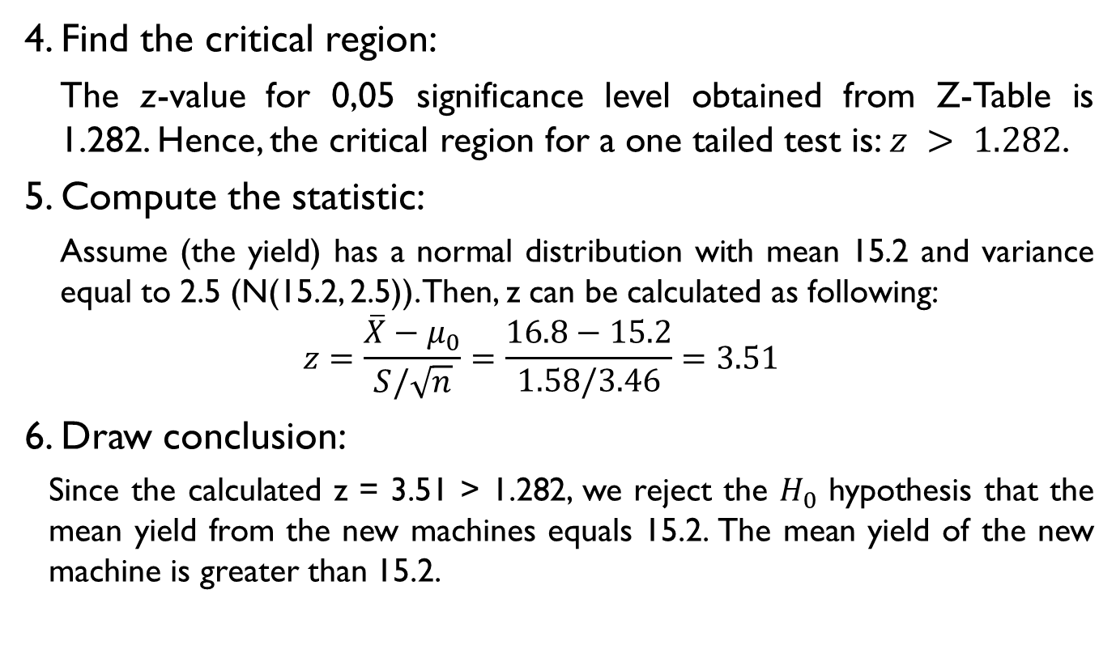
Hypothesis Testing: Example 1
4. Find the critical region:
The z-value for 0,05 significance level obtained from Z-Table is 1.282. Hence, the critical region for a one tailed test is: $z > 1.282$.
5. Compute the statistic:
Assume (the yield) has a normal distribution with mean 15.2 and variance equal to 2.5 (N(15.2, 2.5)). Then, z can be calculated as following:
$$z=\frac{\overline{X}−μ_{0}}{S/\sqrt{n}}=\frac{16.8−15.2}{1.58/3.46}=3.51$$
6. Draw conclusion:
Since the calculated z = 3.51 > 1.282, we reject the $H_{0}$ hypothesis that the mean yield from the new machines equals 15.2. The mean yield of the new machine is greater than 15.2.

Slide 26
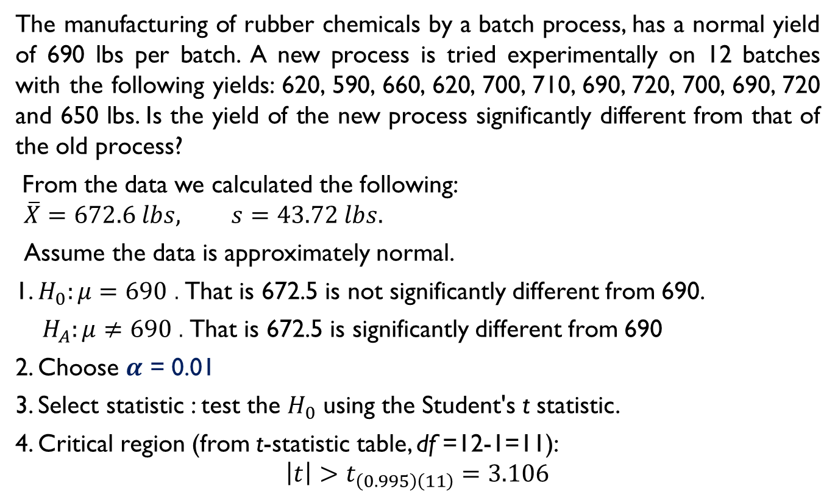
Hypothesis Testing: Example 2
The manufacturing of rubber chemicals by a batch process, has a normal yield of 690 lbs per batch. A new process is tried experimentally on 12 batches with the following yields: 620, 590, 660, 620, 700, 710, 690, 720, 700, 690, 720 and 650 lbs. Is the yield of the new process significantly different from that of the old process?
From the data we calculated the following:
$$\overline{X}=672.6 lbs, s=43.72 lbs.$$
Assume the data is approximately normal.
1. $H_{0}:μ=690$ . That is 672.5 is not significantly different from 690.
$H_{A}:μ≠690$ . That is 672.5 is significantly different from 690
2. Choose $α$ = 0.01
3. Select statistic : test the $H_{0}$ using the Student's t statistic.
4. Critical region (from t-statistic table, df =12-1=11):
$$\left|t\right|>t_{\left(0.995\right)\left(11\right)}=3.106$$

Slide 27
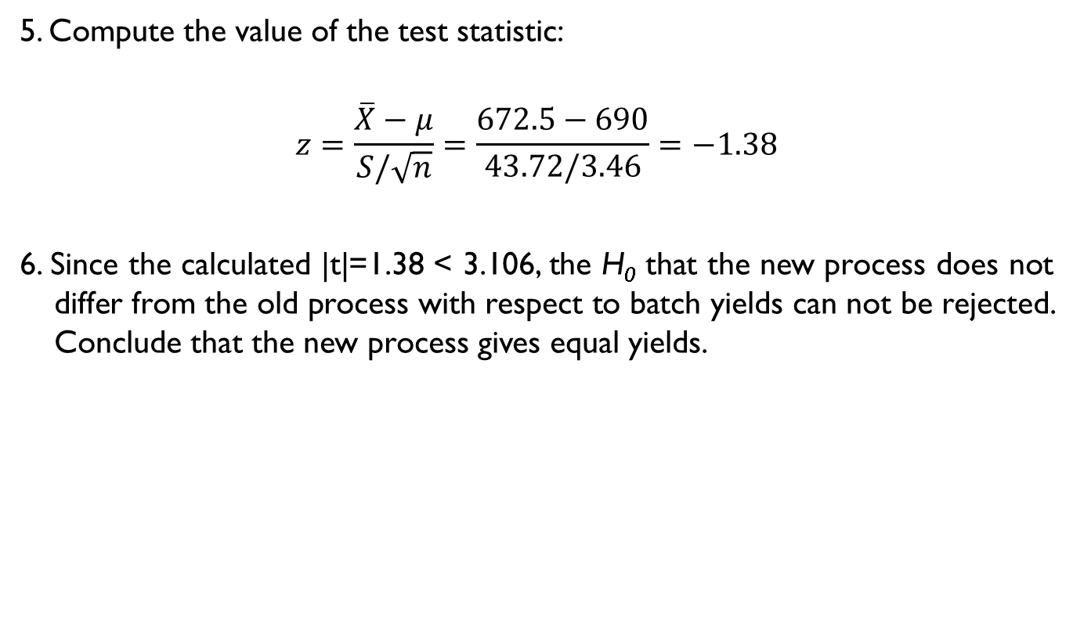
Hypothesis Testing: Example 2
5. Compute the value of the test statistic:
$$z=\frac{\overline{X}−μ}{S/\sqrt{n}}=\frac{672.5−690}{43.72/3.46}=−1.38$$
6. Since the calculated |t|=1.38 < 3.106, the H₀ that the new process does not differ from the old process with respect to batch yields can not be rejected. Conclude that the new process gives equal yields.

Slide 28

Hypothesis Testing: Example 3
A drift test was run at San Angelo to compare Goodyear tires to competitor tires on a Ford Escort. Is there a significant difference in the precision of the results between suppliers?
 | Goodyear | Competitor
No. of tests | 17 | 25
Mean | -27.2 | -39.2
Variance, S² | 132.25 | 207.36
Assume the observations come from two normal distributions.
$$H_{0}:{σ^{2}}_{GDYR}^{}={σ^{2}}_{CMPT}^{}{ vs. H}_{A}:{σ^{2}}_{GDYR}^{}≠{σ^{2}}_{CMPT}^{}$$
2. Choose $α$ = 0.10.
3. Select a test statistic: F statistic with F distribution with (24, 16) degrees of freedom.
4. The critical region obtained from F-Table is:
$$F_{\left(1−\frac{α}{2}\right),\left(n_{1}−1,{ n}_{2}−1\right)=}F_{\left(0,995\right),\left(24,16\right)=2.24}$$

Slide 29
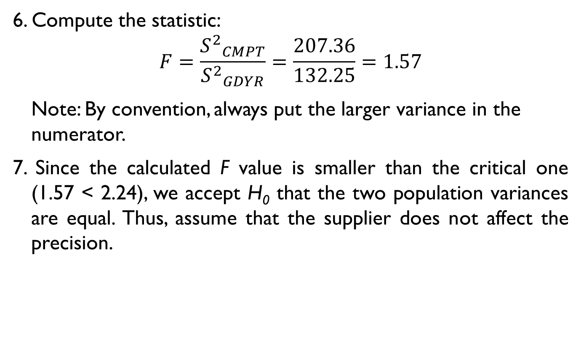
Hypothesis Testing: Example 3
6. Compute the statistic:
$$F=\frac{{S^{2}}_{CMPT}^{}}{{S^{2}}_{GDYR}^{}}=\frac{207.36}{132.25}=1.57$$
Note: By convention, always put the larger variance in the numerator.
7. Since the calculated F value is smaller than the critical one (1.57 < 2.24), we accept H₀ that the two population variances are equal. Thus, assume that the supplier does not affect the precision.

Slide 30
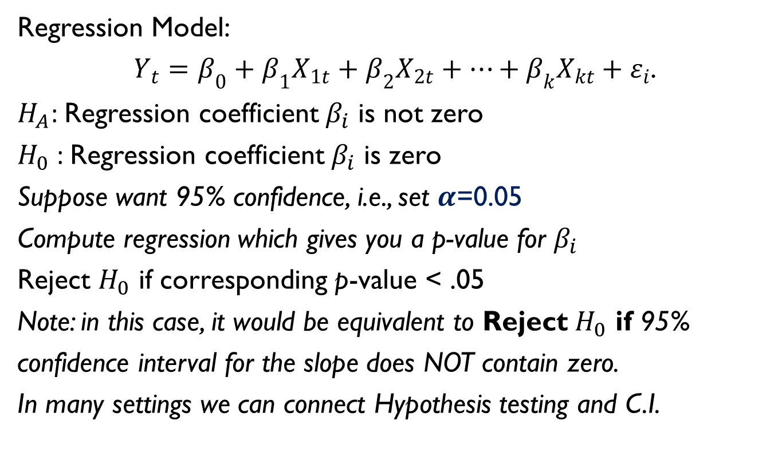
Hypothesis Testing: Example 4
Regression Model:
$Y_{t}=β_{0}+β_{1}X_{1t}+β_{2}X_{2t}+…+β_{k}X_{kt}+ε_{i}$.
$H_{A}$: Regression coefficient $β_{i}$ is not zero
$H_{0}$: Regression coefficient $β_{i}$ is zero
Suppose want 95% confidence, i.e., set $α$=0.05
Compute regression which gives you a p-value for $β_{i}$
Reject $H_{0}$ if corresponding p-value < .05
Note: in this case, it would be equivalent to Reject $H_{0}$ if 95%
confidence interval for the slope does NOT contain zero.
In many settings we can connect Hypothesis testing and C.I.

Slide 31
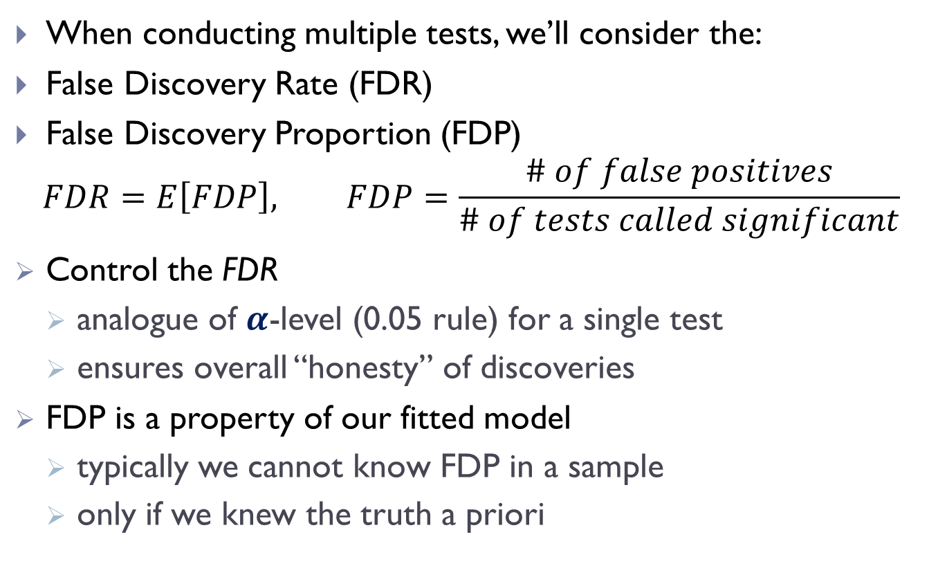
False Discovery Rate
When conducting multiple tests, we’ll consider the:
False Discovery Rate (FDR)
False Discovery Proportion (FDP)
$$FDR=E\left[FDP\right], FDP=\frac{\# of false positives}{\# of tests called significant}$$
Control the FDR
analogue of $α$-level (0.05 rule) for a single test
ensures overall “honesty” of discoveries
FDP is a property of our fitted model
typically we cannot know FDP in a sample
only if we knew the truth a priori

Slide 32
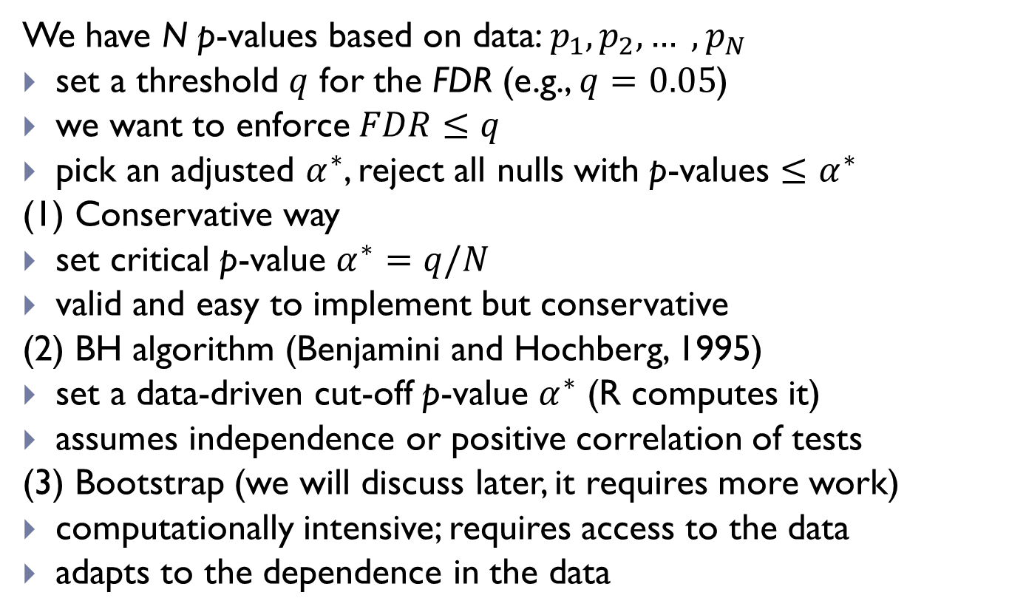
Controlling FDR
We have N p-values based on data: $p_{1},p_{2}, … ,p_{N}$
set a threshold $q$ for the FDR (e.g., $q=0.05$)
we want to enforce $FDR≤q$
pick an adjusted $α^{∗}$, reject all nulls with p-values $≤α^{∗}$
(1) Conservative way
set critical p-value $α^{∗}=q/N$
valid and easy to implement but conservative
(2) BH algorithm (Benjamini and Hochberg, 1995)
set a data-driven cut-off p-value $α^{∗}$ (R computes it)
assumes independence or positive correlation of tests
(3) Bootstrap (we will discuss later, it requires more work)
computationally intensive; requires access to the data
adapts to the dependence in the data

Slide 33

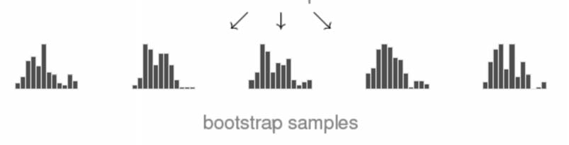
Multiple Testing via Bootstrap
Idea: if data is similar to the population
draw from the data to have multiple samples
compute multiple tests on each subsample
R combines to form p-values in the original analysis

Slide 34
Multiple Testing via Bootstrap
Bootstrap was conceived in the late 80’s (Efron)
among the major break through in Statistics
Good properties
accounts for dependence across tests
adapts to finite sample (potentially non-normal)
Keep in mind
computationally intense
need access to the data and run the methods
not only the p-values like “conservative” and “BH” algorithm

Slide 35
Simultaneous C.I. via Bootstrap
Bootstrap is widely used to construct confidence intervals
adapts to finite sample (potentially non-normal)
R computes the confidence interval via simulation
Also works to create simultaneous confidence intervals
accounts for dependence across confidence intervals
non-conservative (e.g. 95% that all coefficients are in their confidence intervals)
very useful in multiple regression (adjusts critical value)
Keep in mind that it is computationally intense
e.g. in regression, one needs to run hundreds of regressions

Slide 36
Resampling methods
Resampling methods involve repeatedly drawing samples from a training set and refitting a model of interest on each sample in order to obtain additional information about the fitted model.
For example, in order to estimate the variability of a linear regression fit, we can repeatedly draw different samples from the training data, fit a linear regression to each new sample, and then examine the extent to which the resulting fits differ.
The most commonly used resampling methods, cross-validation and the bootstrap.

Slide 37
Resampling methods
The process of evaluating a model’s performance is known as model assessment, whereas the process of selecting the proper level of flexibility for a model is known as model selection.
The use of a particular statistical learning method is warranted if it results in a low test error.
The test error is the average error that results from using a statistical learning method to predict the response on a new observation – that is, a measurement that was not used in training the method.
Validation set approach involves randomly dividing the available set of observations into two parts, a training set and a validation set or hold-out set.
The model is fit on the training set, and the fitted model is used to predict the responses for the observations in the validation set.

Slide 38
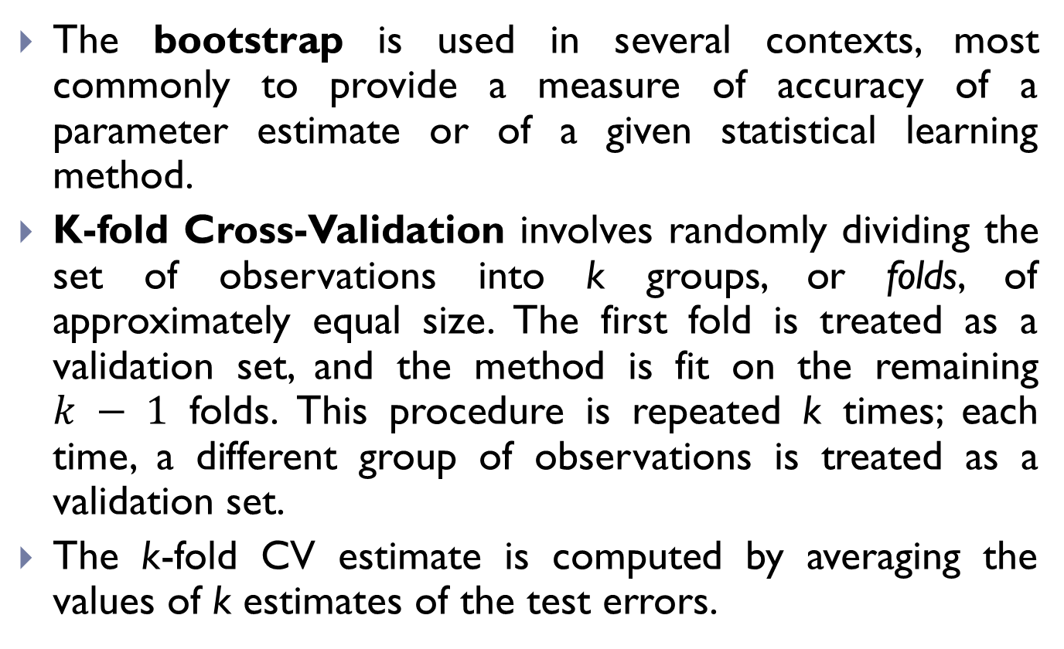
Bootstrap vs. Cross-Validation
The bootstrap is used in several contexts, most commonly to provide a measure of accuracy of a parameter estimate or of a given statistical learning method.
K-fold Cross-Validation involves randomly dividing the set of observations into k groups, or folds, of approximately equal size. The first fold is treated as a validation set, and the method is fit on the remaining $k − 1$ folds. This procedure is repeated k times; each time, a different group of observations is treated as a validation set.
The k-fold CV estimate is computed by averaging the values of k estimates of the test errors.

